Slide 1
Parkinson’s Disease Detection
Innovative Diagnostic Tool Using Vocal Features
TEAM MEMBERS
HARSHITH REDDY BODDIREDDY
PRANAY DATTA KAVUKUNTLA

Slide 2
Agenda
Introduction
Project Goals
Methodology
Dataset
Model Development
Performance Statistics
Conclusion

Slide 3
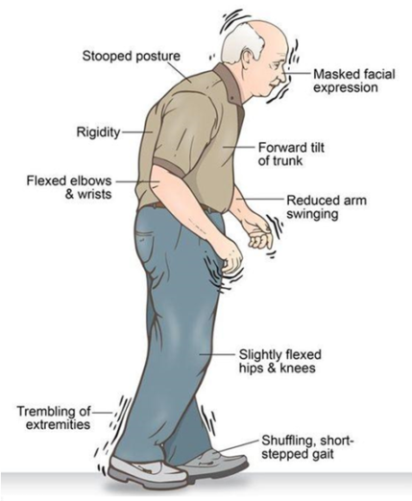
Introduction
Parkinson's disease is a neurodegenerative disorder affecting movement and speech capabilities.
Early detection is critical for effective treatment and can profoundly impact patient care outcomes.
Recent advancements in machine learning present new opportunities in early, non-invasive diagnostics.
The innovative project outlined integrates technology and medicine to identify early Parkinson's signs.
Photo by Pexels

Slide 4
Project Goals
A principal objective is establishing a non-invasive method to detect early Parkinson's disease.
Our model aims for 90% accuracy using vocal biomarkers, addressing the delay in conventional diagnosis.
Through technology, the goal is to render earlier interventions feasible, offsetting disease progression.
Documenting each phase, from design to execution, is vital for tracking progress and validating results.
Photo by Pexels

Slide 5
Methodology
built a website where people may enter their voice measures and receive a forecast
Choice of the XGBoost algorithm stems from its robust performance in complex classification tasks.
Feature extraction isolates vocal markers like pitch variation, often early indicators of Parkinson's.
Preprocessing ensures high-quality data input, crucial for a machine learning model's success.
Metrics like F1 score and recall measure the model's effectiveness, ensuring clinical reliability.
Development of a webpage for input their vocal measurements and receive a prediction
Photo by Pexels

Slide 6
DataSet
Vocal Measurements
JITTER: Measures frequency variations in the voice, indicating vocal fold vibration irregularities.
SHIMMER: Reflects amplitude variations, highlighting issues with vocal cord control.
HARMONIC TO NOISE RATIO (HNR): Assesses the ratio of harmonic sound to noise, indicating voice quality and clarity.
0
1

Slide 7

Model Development
In machine learning and data science, XGBoost—eXtreme Gradient Boosting—is a fast and scalable gradient boosting method. It excels in classification and regression.
XGBClassifier builds 100 decision trees (n_estimators) to balance complexity and accuracy and has a learning rate (eta) of 0.3 to moderate training speed and avoid overfitting. Preventing overfitting limits tree depth to 2 (max_depth). For this data, it employs gbtree's tree-based model structure and the error evaluation metric to reduce misclassification. Set to 0, the seed parameter fixes the random seed for consistent results.
Used HTML, CSS, and JavaScript for front-end design and interactivity, and Python and Flask for backend server functionality.
Photo by Pexels

Slide 8
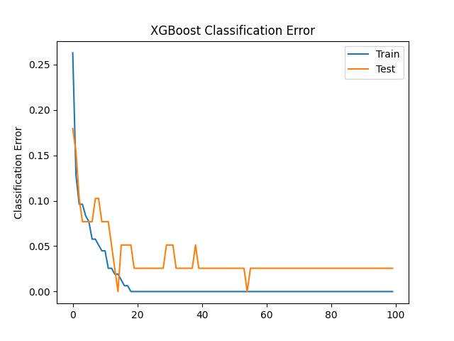
Performance Statistics
ANALYSING THE TRAINED MODEL:
This graph shows the classification error of our XGBoost model over 100 epochs, comparing performance on the training set versus the test set. The sharp decrease in error at the initial epochs indicates rapid learning, while the stabilization of the lines shows that the model achieves consistency.
This visualization helps in understanding the model's ability to generalize from the training data to unseen test data, which is critical for real-world application.
Photo by Pexels

Slide 9
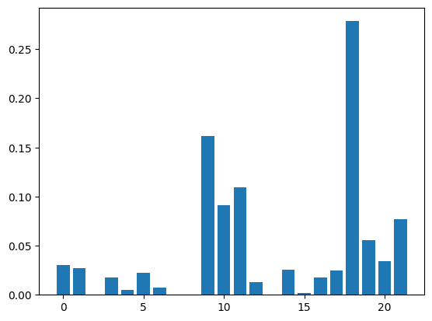
Performance Statistics
FEATURE IMPORTANCE ANALYSIS:
This plot displays the importance of each feature used by the XGBoost model in making predictions. Features are ranked by their scores on the x-axis, showing their relative importance in the model.
Higher bars represent features that have more significant impacts on the model’s decisions, helping us focus on the most relevant factors for Parkinson's disease detection. This analysis is essential for refining the model and understanding which vocal features are most indicative of the disease.
Photo by Pexels

Slide 10
Performance Statistics
KFOLD VALIDATION WITH 5 FOLDS
This plot displays the importance of each feature used by the XGBoost model in making predictions. Features are ranked by their scores on the x-axis, showing their relative importance in the model.
Higher bars represent features that have more significant impacts on the model’s decisions, helping us focus on the most relevant factors for Parkinson's disease detection. This analysis is essential for refining the model and understanding which vocal features are most indicative of the disease.
Photo by Pexels

Slide 11
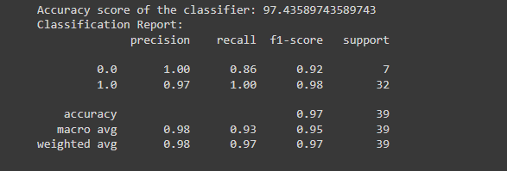
Performance Statistics
MODEL PERFOMANCE STATISTICS
This slide highlights the overall performance of our XGBoost classifier, with an accuracy score of 97.4359%. The classification report provides detailed metrics including precision, recall, and F1-score for each class. These metrics illustrate the model's effectiveness in accurately identifying and classifying cases of Parkinson's disease, ensuring high reliability for clinical use.
Photo by Pexels

Slide 12

Conclusions
The completion of our project presents an accurate diagnostic tool for early Parkinson's detection.
Our system showcases vast potential for enriching medical diagnostics using machine learning.
The high accuracy achieved marks a significant stepping stone towards non-invasive diagnostics.
We extend our gratitude for the opportunity to contribute to Parkinson’s disease diagnostics.

